Slide 1
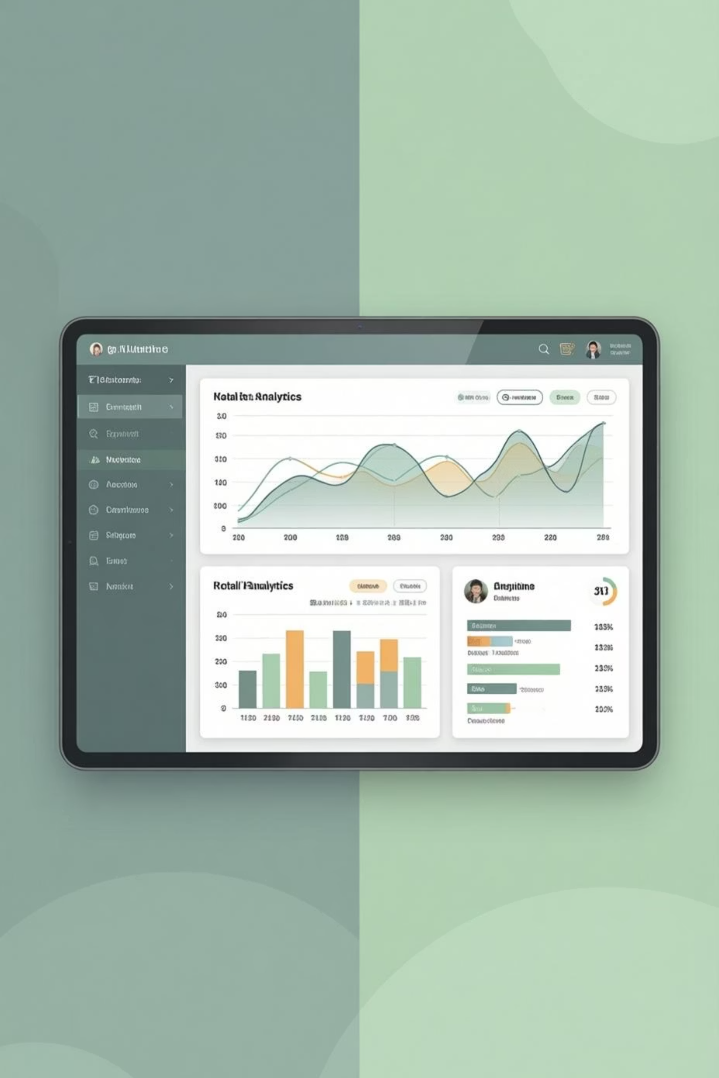
Customer Shopping Behavior Analysis
Analyzing 3,900 customer transactions to uncover insights into spending patterns, customer segments, and product preferences that drive strategic business decisions.

Slide 2
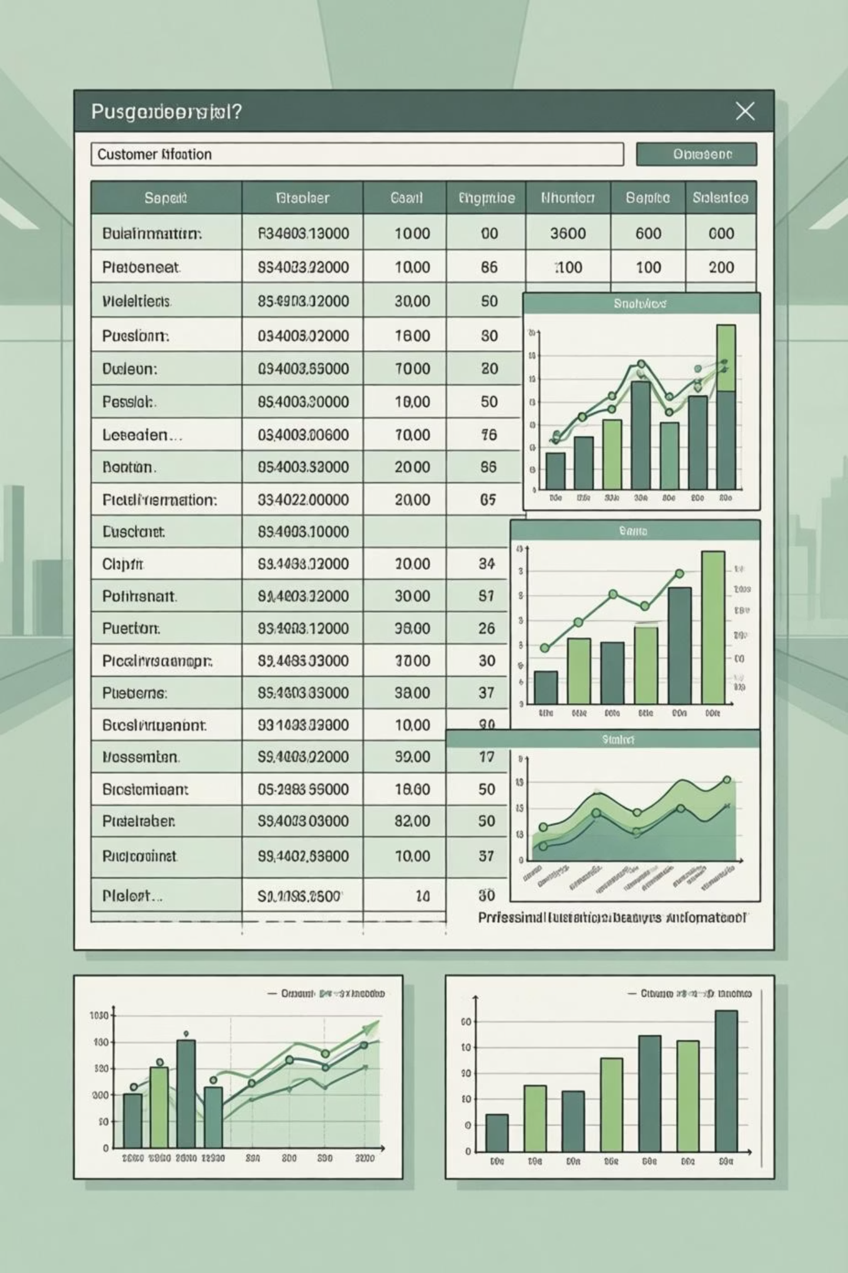
DATASET OVERVIEW
Understanding Our Data Foundation
3,900
18
37
Total Transactions
Data Features
Missing Values
Customer purchases analyzed across all categories
Comprehensive attributes covering demographics and behavior
Only in Review Rating column, handled via median imputation
Dataset includes customer demographics, purchase details, shopping behavior metrics, and subscription status across clothing, footwear, accessories, and outerwear categories.

Slide 3

PYTHON ANALYSIS
Data Preparation & Feature Engineering
01
02
03
Data Loading & Exploration
Missing Data Handling
Column Standardization
Imported dataset using pandas, examined structure with df.info() and summary statistics
Imputed 37 missing Review Rating values using median rating per product category
Renamed columns to snake_case format for consistency and readability
04
05
Feature Engineering
Data Validation
Created age_group categories and converted purchase frequency to numeric days
Removed redundant promo_code_used column after confirming it matched discount_applied

Slide 4
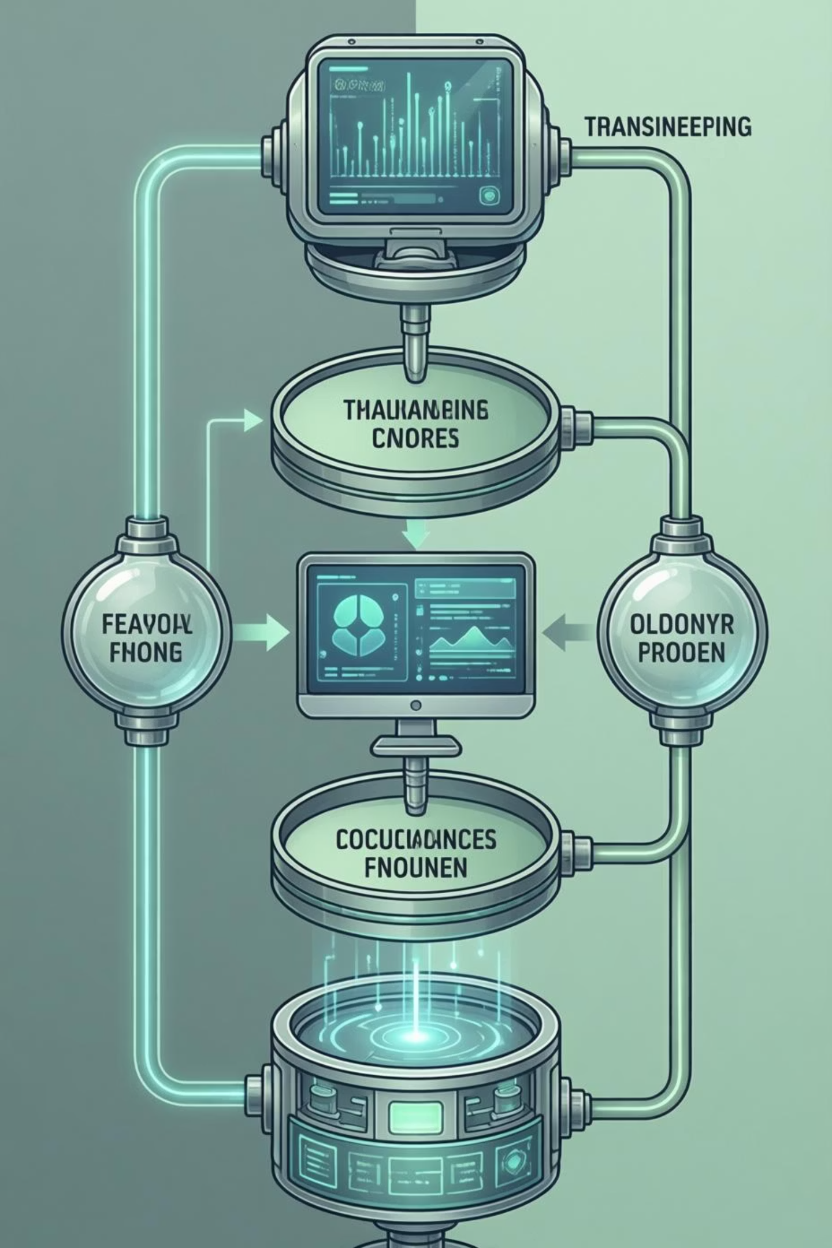
Key Feature Transformations
Age Segmentation
Purchase Frequency Mapping
Grouped customers into four meaningful segments for targeted analysis:
Converted textual frequencies to numeric days between purchases:
Young Adult (18-30)
Adult (31-45)
Weekly → 7 days
Middle-aged (46-60)
Fortnightly → 14 days
Senior (60+)
Monthly → 30 days
Quarterly → 90 days

Slide 5

SQL ANALYSIS
Business Insights from Transactions
1
2
Revenue by Gender
Top-Rated Products
Male customers generated $157,890 vs. Female $75,191 in total revenue
Gloves (3.86), Sandals (3.84), and Boots (3.82) lead in customer satisfaction
3
4
Shipping Preferences
Discount Impact
Express shipping customers spend $60.48 avg vs. $58.46 for Standard
Hat (50%), Sneakers (49.66%), and Coat (49.07%) have highest discount rates

Slide 6

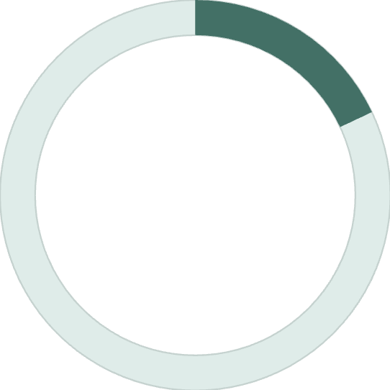


Customer Segmentation Analysis
80%
18%
2%
Loyal Customers
Returning Customers
New Customers
3,116 customers with 10+ previous purchases
701 customers with 2-10 previous purchases
83 first-time buyers in the dataset
Subscription Insights
Among repeat buyers with 5+ purchases: 958 are subscribers while 2,518 are not. This reveals significant opportunity to convert loyal non-subscribers.

Slide 7
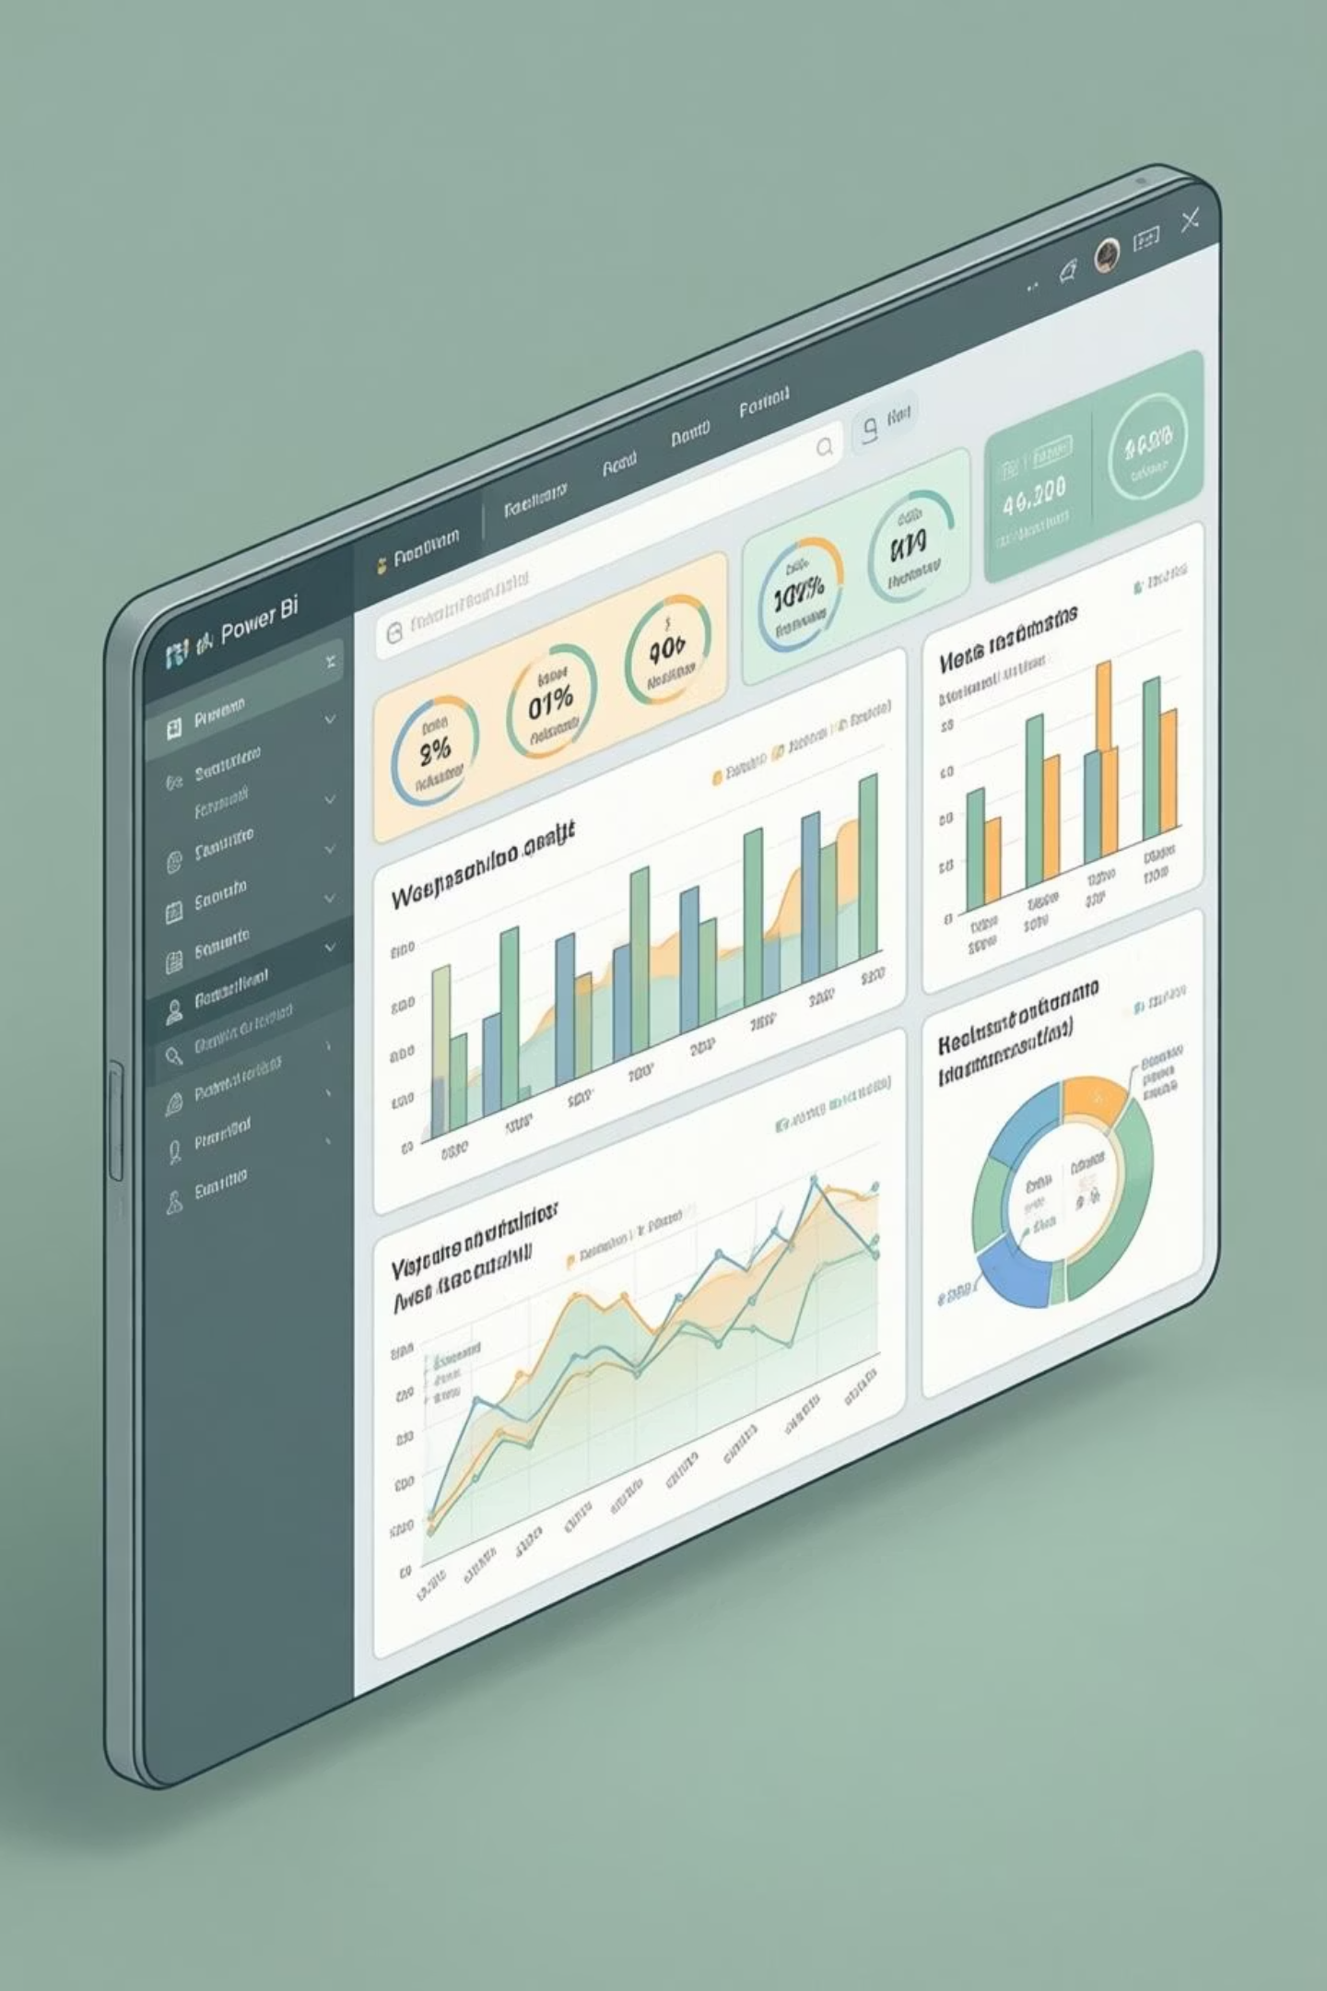
POWER BI DASHBOARD
Interactive Visual Analytics
3.9K Customers
Total analyzed across all segments
$59.76 Avg Purchase
Consistent spending across categories
3.75 Avg Rating
Strong customer satisfaction overall
73% Non-Subscribers
Major conversion opportunity
Dashboard reveals Clothing dominates revenue (~$100K), Young Adults lead spending ($62K), and most customers prefer free shipping options.

Slide 8





STRATEGIC RECOMMENDATIONS
Actionable Business Strategies
Boost Subscriptions
Promote exclusive benefits to convert the 73% non-subscriber base, especially among loyal repeat buyers
Loyalty Programs
Reward repeat buyers to accelerate movement from Returning to Loyal customer segments
Optimize Discounts
Balance promotional strategies to boost sales while protecting profit margins across categories
Highlight Top Products
Feature high-rated items like Gloves and Sandals prominently in marketing campaigns
Targeted Marketing
Focus efforts on Young Adults and express-shipping users who demonstrate higher spending patterns

